Slide 1

Sebe Msomi
Moipone Kabai

Slide 2
Process analysis
We use process analysis to understand what is going on in our process. We assessed our current system, practice weaknesses and identified bottlenecks. We will be looking for information about the process’s problem and inefficiencies. The process models will describe the process that may be developed, and it will focus on process characteristics such as rapidity and robustness.
We have identified key characteristics to remain successful and profitable during level 3 lockdown. We used one of the process analysis techniques to improve our tourism system. The most common technique we used was questionnaires and interviews. We basically questioned the developers and all the people involved in building tourSpace system abut what is happening.

Slide 3
Process analysis continued
We chose to use questionnaires to discover the extent of which good software engineering practices are used.
We used process analysis to understand the activities involved in the process and the relationship between these activities. To understand the tourSpace system process activities and the measurements that have been made.

Slide 4
Process Change
Improvement identification – we will use the results of the process analysis to identify ways to challenge quality problems such as travel restrictions, accommodation bookings are not allowed, and restaurants are closed. Cost inefficiencies that we have identified during tourism system analysis. We propose to implement new processes, process structures, methods and tools to address the problems we outlined. We write these new changes using best practice guide. We will redefine our requirements of the tourSpace system to incorporate them with the new changes.
We will propose new methods that allow our tourism system to display all accommodations and restaurants that are open for domestic traveling and operating during level 3. create methods that increase revenue.

Slide 5
Process Change
Process change introduction – we will implement the methods that we have proposed during the improvement identification stage and we will integrate these methods with other activities and ensure compatibility between these process activities. We will set enough time to introduce the changes and to ensure our system is compatible with other process activities, procedures and standards. The tourSpace will acquire tools for requirements management and designing processes to use these tools.

Slide 6
Process Change
Process training – as the developers that have been involve during the building of the tourSpace system, it will not be a challenge to incorporate and understand these new proposed changes and how to implement them.
The training that we will be required would be when new tools are introduced. In the training session, we will have discussions of the value of requirements management, explain the process activities and introduce the tools that we selected

Slide 7
Process Change
Change tuning – we will perform a test on our tourSpace system to discover minor problems. After discovering these problems. The process changes will never be effective as soon as they are introduced. Introducing too many changes makes it impossible to assess the effect of each change on the process. we will propose and introduce modifications to the process and if we are happy with the process, the changes will be completely operative.
We will make this phase to last for few months to discover defects and to make sure all the changes have been made successfully and the system is going to production.

Slide 8
Process Change
Improvement prioritization – we will assess all the possible changes on our tourSpace system and prioritize them for implementation. We will prioritize the changes based on criticality. We will start with the high, medium and low priority therefore to avoid introducing all the changes at once. We will not make too many changes at once but we will consider introducing requirements management processes to manage evolving requirement to the highest process change.
We will decide on the process areas that need improvement, how much to introduce these changes and their impact on our tourSpace system.

Slide 9
Implement Process Change
We will implement these changes by developing a communication strategy that include a timeline for how the change will be incrementally communicated and how will the change be communicated. Provide effective training to teach the skills and knowledge required to operate efficiently. We will introduce new practices, methods and tools as well as new roles or responsibilities. Measure the change process to ensure that we have achieved our goal which is to reduce the number of defects discovered during integration testing. We will use the process measurements to assess the effectiveness of the changes on our tourSpace system.

Slide 10
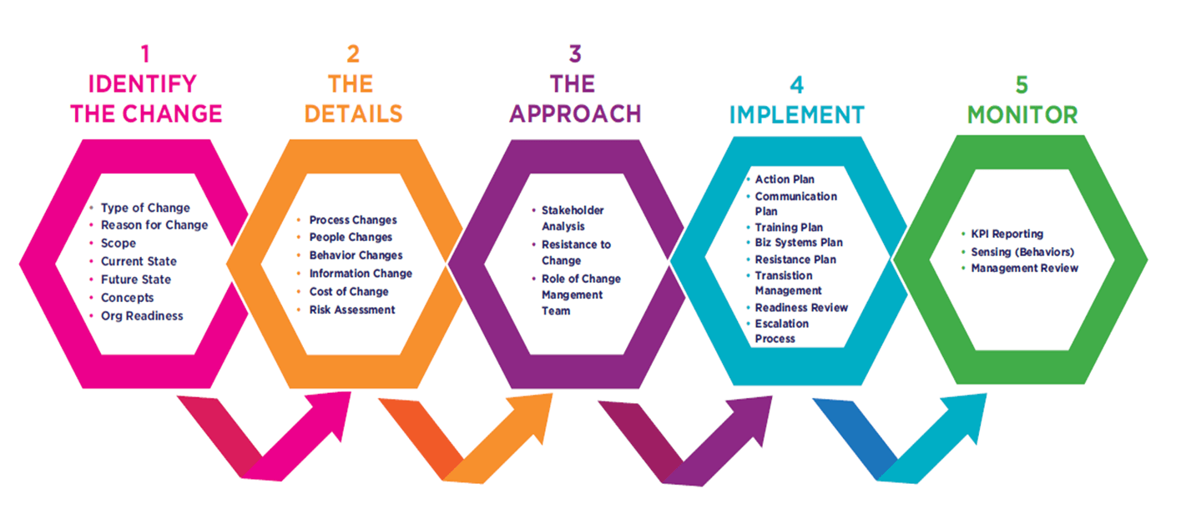
Process Change

Slide 11
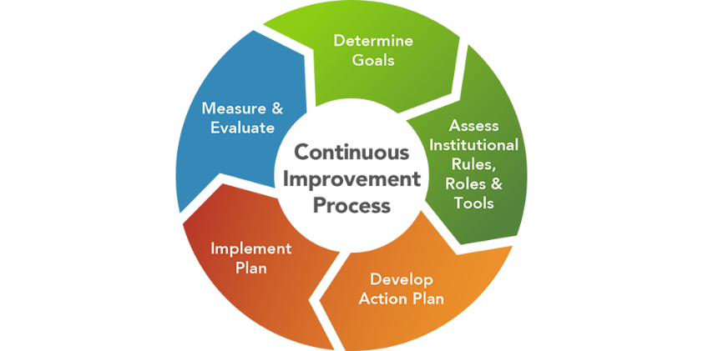
Process Change

Slide 17
Past the ½ way

Slide 20
DONE!

